Slide 1
Applications of Representation Learning

Slide 2
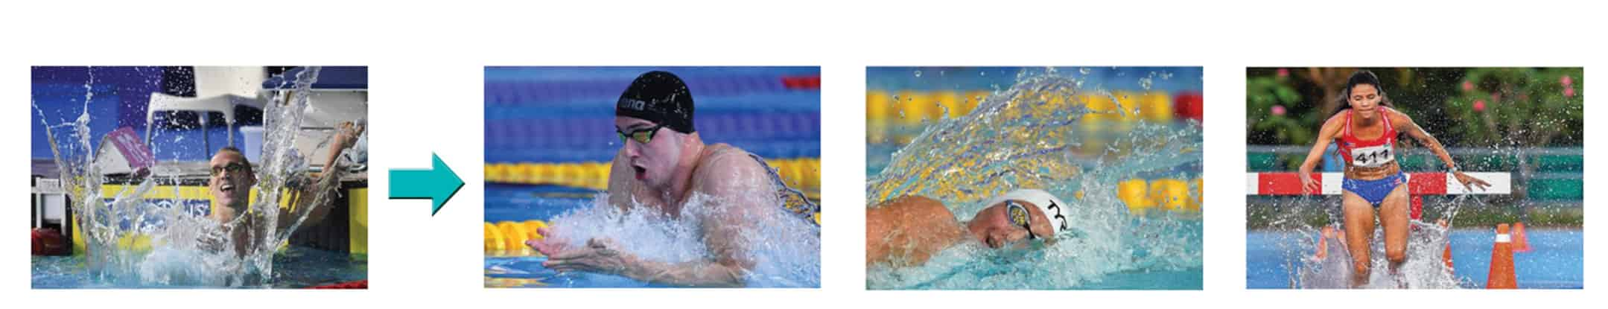
Retrieval
One of the most immediate applications is retrieval
Given image x, find the K most similar images in dataset D
Poorly defined, similar according to which attribute?

Slide 3
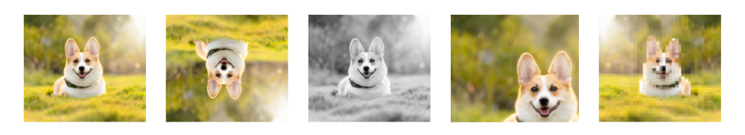
Semantic Representation
We have already tackled this issue, two options:
Use supervision on labelled similar images
Use generative augmentation to tell us which attributes don’t count
Method from previous weeks learn image to representation encoder

Slide 4

Retrieval in Practice
Simple:
Use encoder to extract representations for all images
Compute K nearest neighbors
Choice of metric matters (L1, L2, cosine)
Hubness problem – some representations similar to most

Slide 5
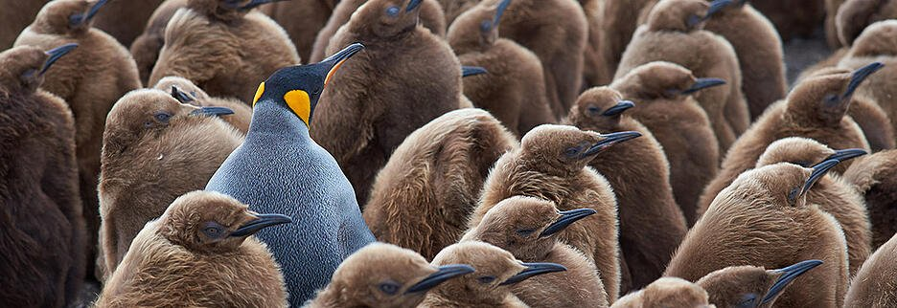
Anomaly Detection
Objective: Discovering unique, interesting phenomena

Slide 6
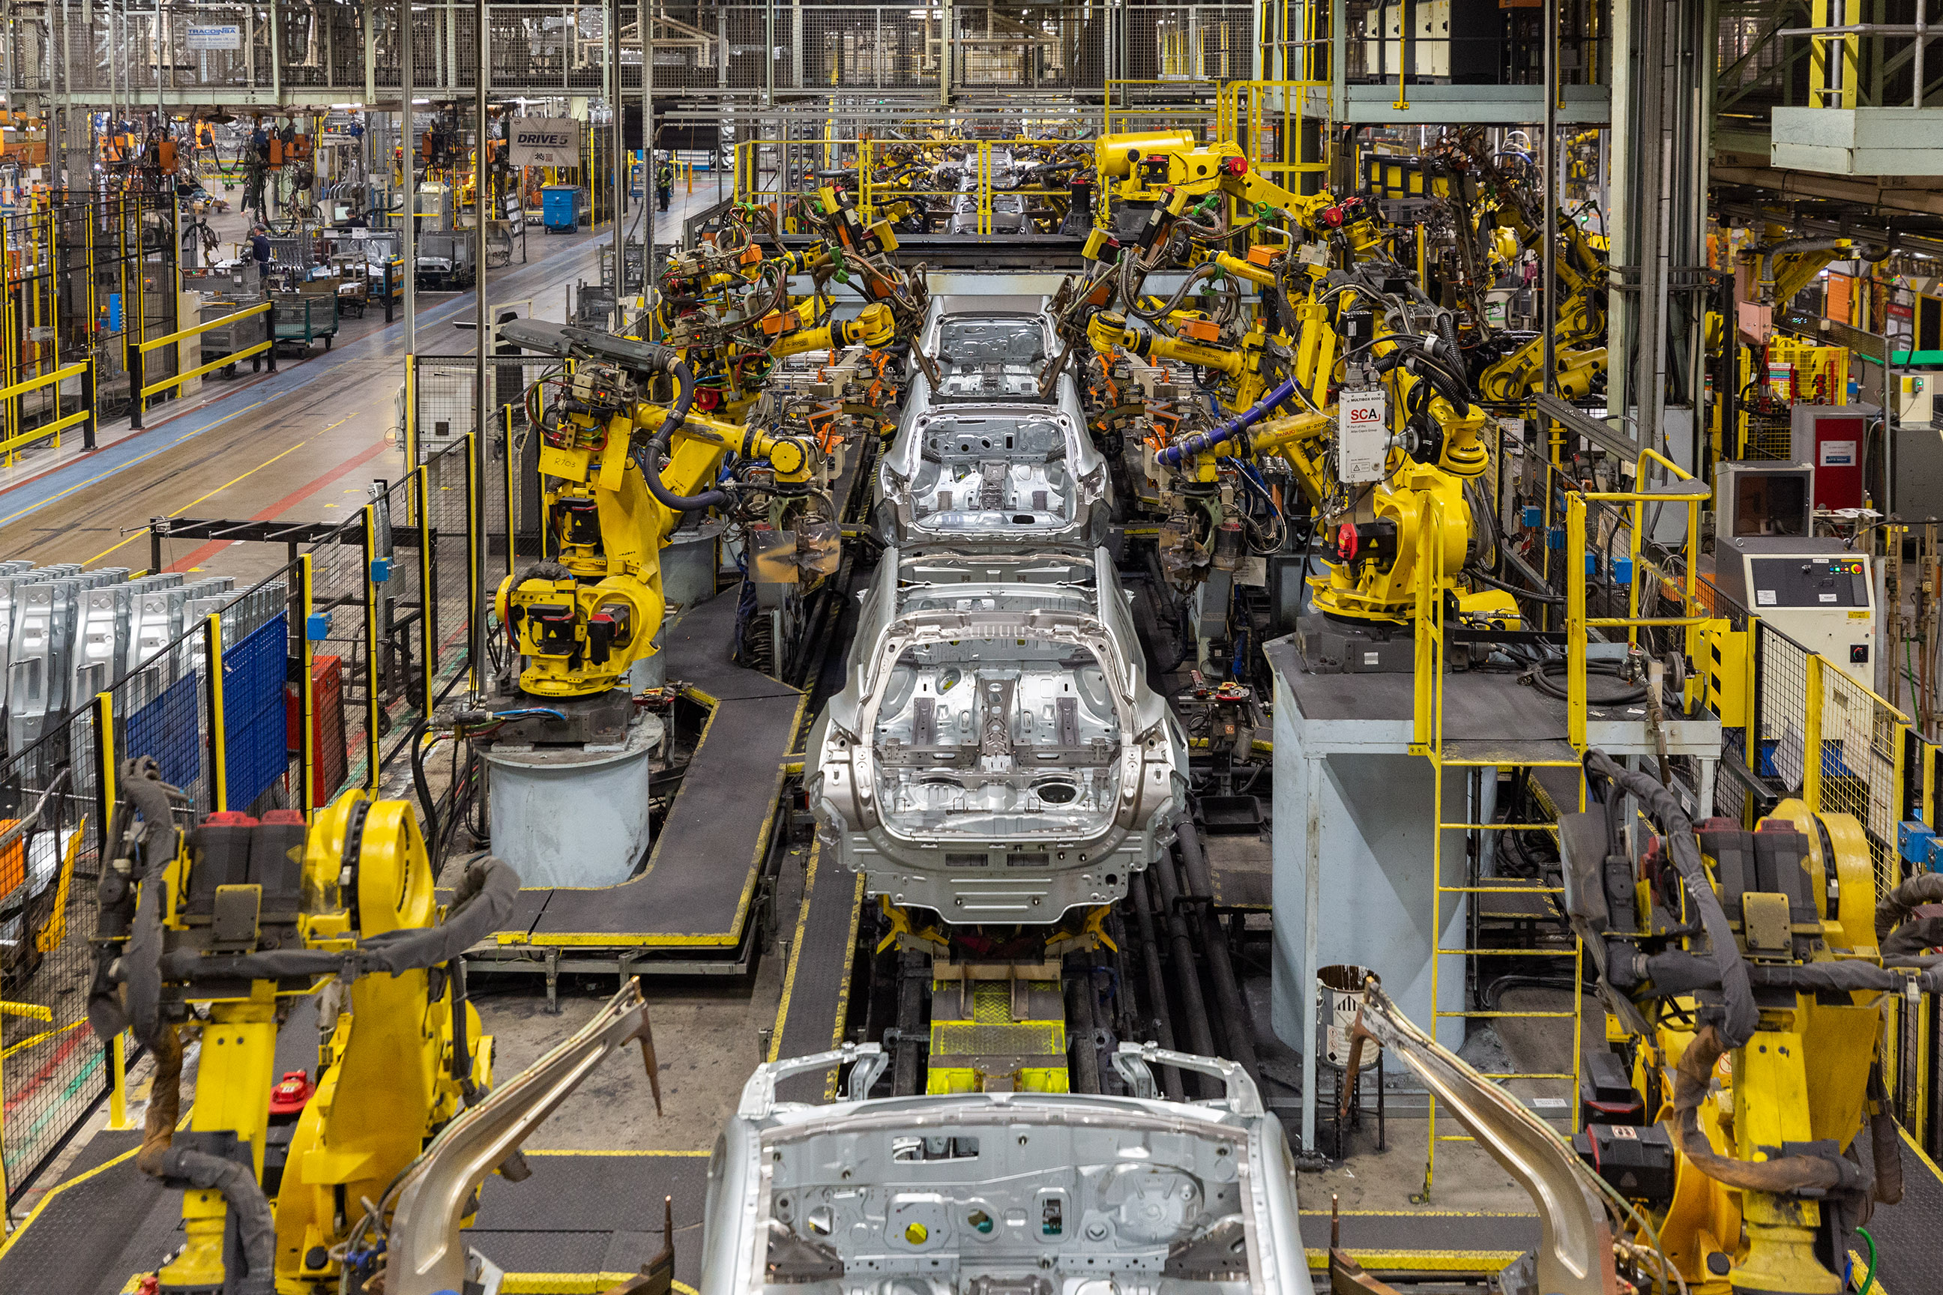
Why is it important? – Cyber and Manufacturing
Cyber security: unusual program signatures, network activity
Production line: discovering faulty products

Slide 7
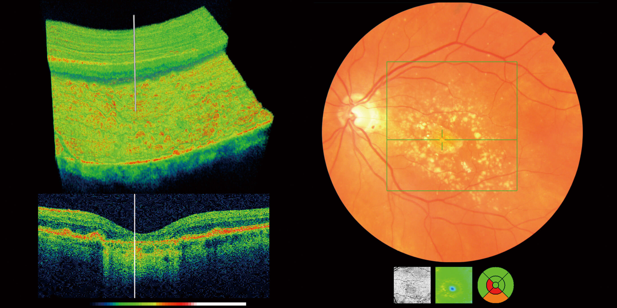
Why is it important? – Medicine
Finding biomarkers for early discovery of disease in routine medical scans

Slide 8

Anomaly detection is key for discovery
Thomas Kuhn, The Structure of Scientific Revolutions (1962)
“Discovery begins with the awareness of anomaly”
“The paradigm change is complete when the paradigm has been adjusted so that the anomalous become the expected. “
The result is that the scientist is able to see nature in a different way”

Slide 9
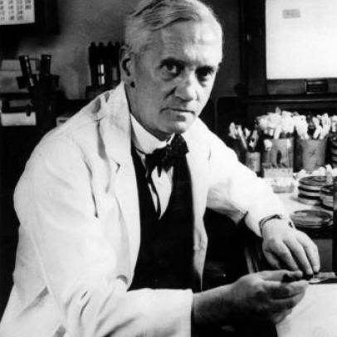
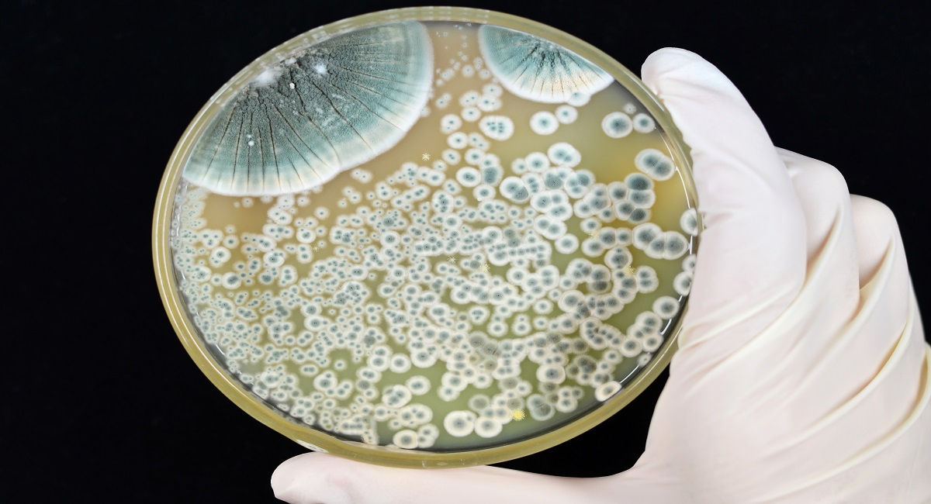
Discovery of Penicillin
Fleming returned from vacation and inspected his petri dishes
Dishes contained bacteria everywhere except for for moldy areas
This anomaly lead to the discovery of Penicillin

Slide 10
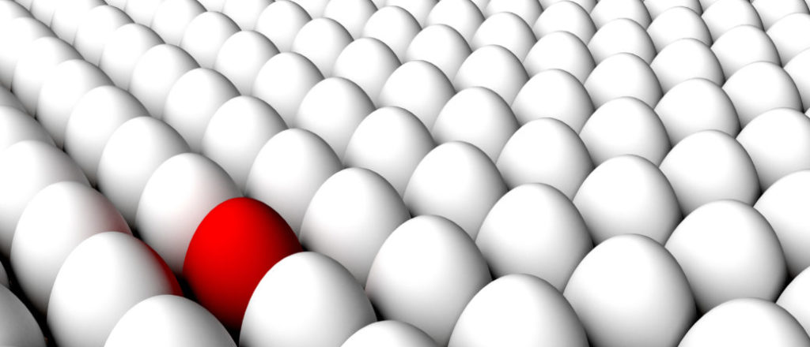
Standard Setting
Task: Detect if a new sample is different from previously seen
Training stage: Observe normal samples and train model
Inference: Observe new sample and decide:
Similar to previously seen? - Normal
New pattern? - Anomaly

Slide 11
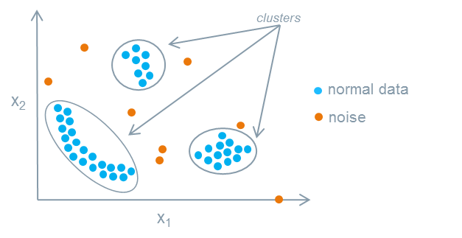
Reformulating Anomaly Detection as Density Estimation
One definition of anomaly: sample that lies in a low-density region of space
Intuition: few samples are similar to the anomaly
Classifier:
Low probability (p(x) < th): Anomaly
High probability (p(x) > th): Normal

Slide 12
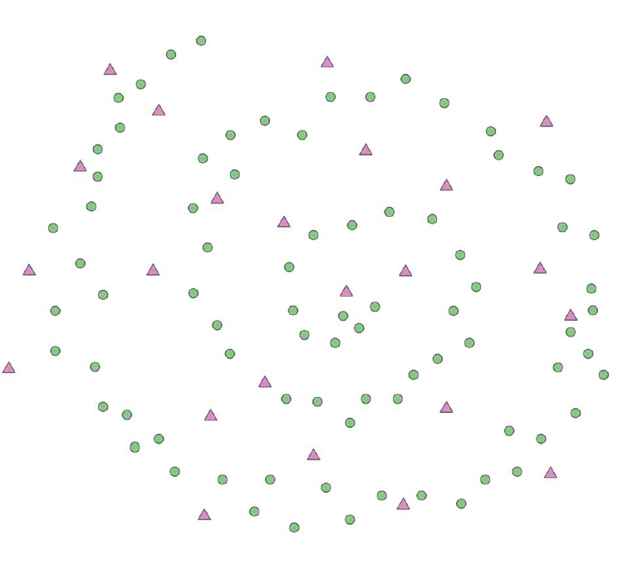
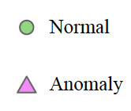
Challenge #1: Estimation is Hard
Estimation of probabilistic models from a small sample size is hard
A key objective of statistics
Particularly hard for high-dimensional, non compact data.
We have learned many methods…

Slide 13
Challenge #2: Representation Must Capture Interesting Variation
Consider a representation that contains two parts (c, u)
c is correlated with semantic anomalies, u is correlated with nuisance attributes
E.g. representations of production line images may have two parts:
c: presence of cracks and scratches
u: different orientation of camera, we consider this attribute as nuisance
An unusual value of u will trigger an anomaly, but is not semantically interesting

Slide 14
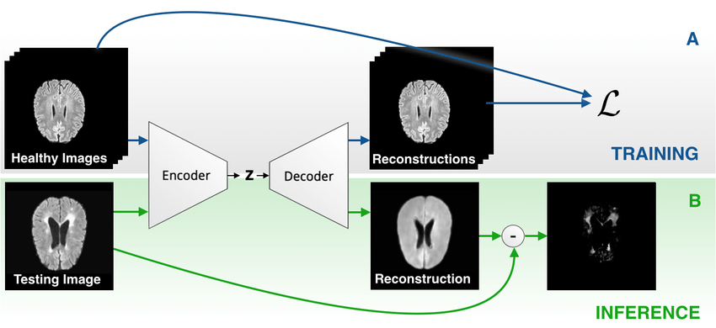
Out-of-Distribution Generalization
Out-of-distribution generalization (OOD)
Idea:
train a classifier/autoencoder on normal data
At test time evaluate accuracy of model
Assumption: model generalizes better on normal (in-distribution) data than on OOD

Slide 15
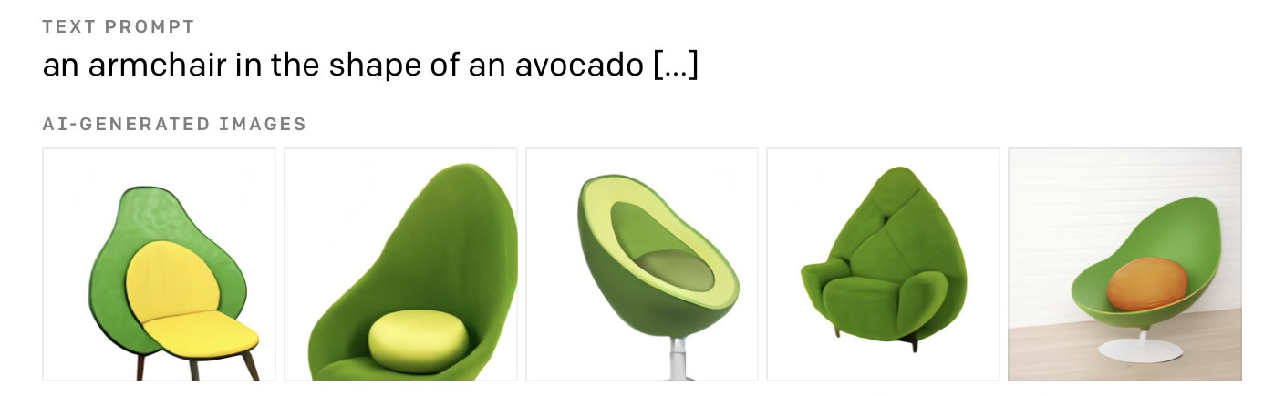
Most Deep AD Focus on Poor OOD Generalization
Deep learning methods famously generalize poorly out-of-distribution
Best case: classifier performs well in-distribution, poorly OOD
Limitation: deep networks don’t always generalize poorly OOD

Slide 16
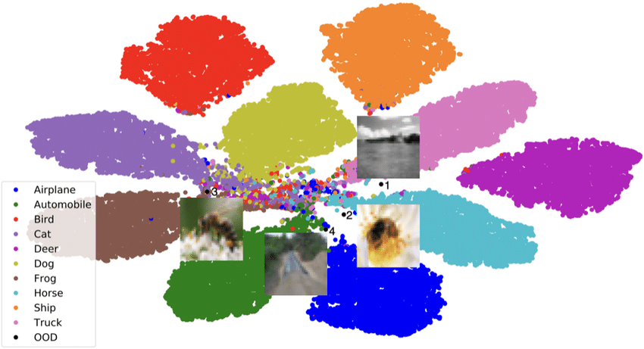
Our Approach: Representation is All You Need
Effective deep representation can overcome both classical limitations:
Density estimation is easier due to reduced dimension and denser support
More informative representation – more correlated to semantic anomalies

Slide 17
Which Representation Encoder?
Previous: self-supervised representations trained only on normal data
E.g. autoencoders, rotnet, contrastive learning
Missed opportunity - huge external resources exist e.g. ImageNet dataset
Our approach: use external (unrelated) data to pretrain power representation encoders

Slide 18
Experiment #1: Deep Nearest Neighbors
How powerful are deep representations coupled with trivial density estimation?
Extracted deep representation from each image using a ResNet trained on Imagenet
Scored each test image by the distance to the kNN in the training set in feature space

Slide 19
Experiment #1: Results
DN2 achieves better results that much more complex SOTA methods
Representation quality is more important than the statistical model

Slide 20
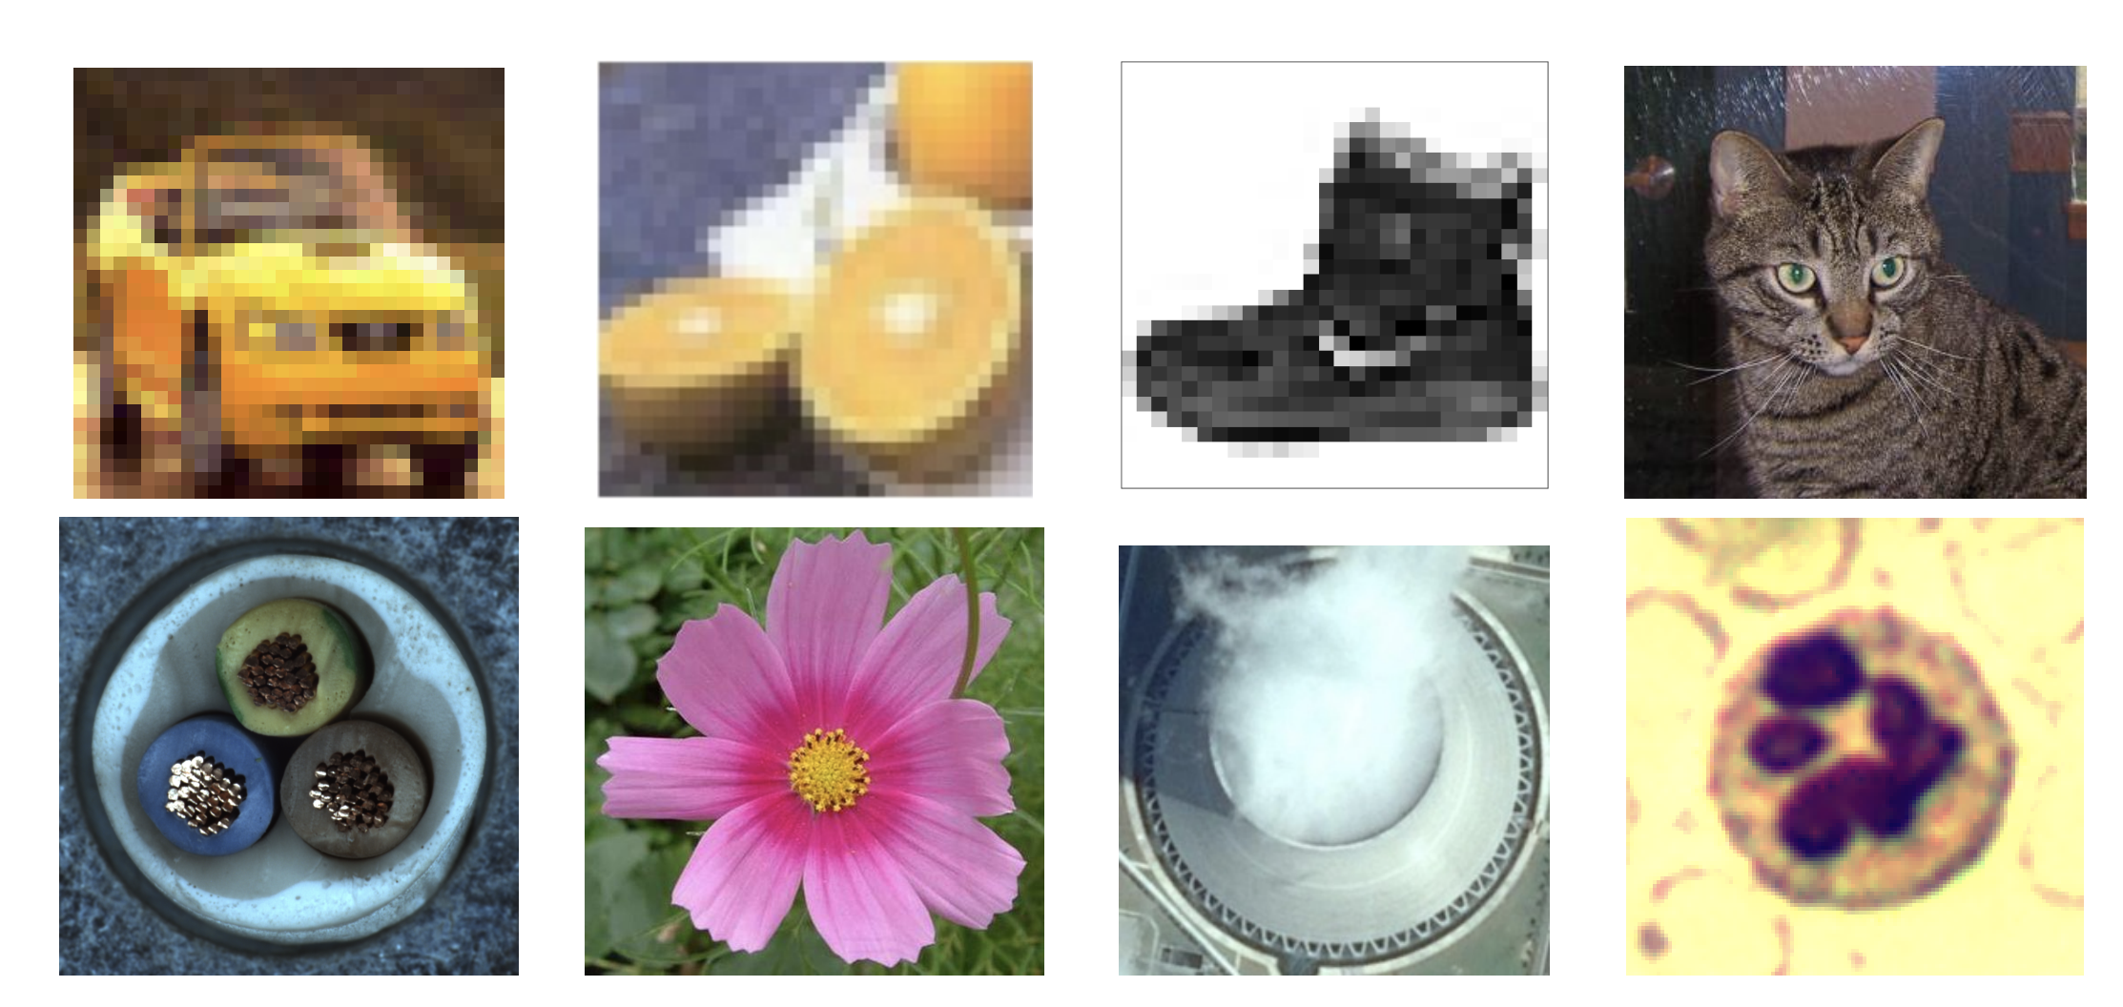
Experiment #1: Generality Across Datasets
ImageNet-pretrained feature encoders generalize well across many image datasets
We could even use it to segments foreign language into words (Fuchs et al., Interspeech’22)

Slide 21
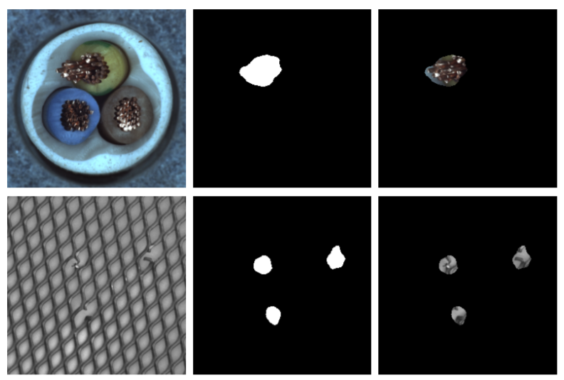
Experiment #2: Deep Anomaly Segmentation
Task: label all image pixels as normal or anomalous
Cohen, and Hoshen. Sub-image anomaly detection with deep pyramid, 2020

Slide 22
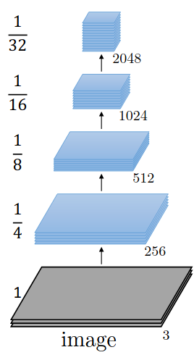
Experiment #2: Deep Anomaly Segmentation
Method: same as DN2, but a representation is extracted for every pixel
We named the method SPADE
Per-pixel features extracted by concatenating different later activations
Encoder is pretrained on ImageNet
kNN is performed vs. all the pixel representations in the train set

Slide 23
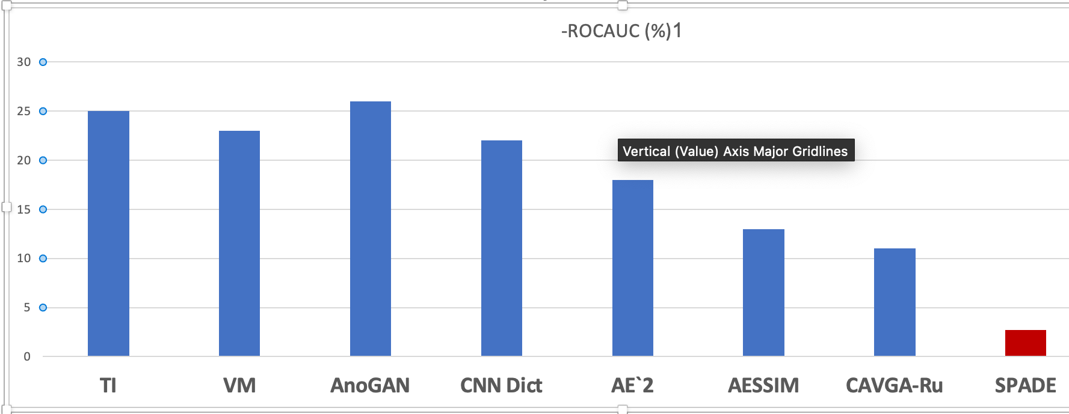
Experiment #2: SPADE Results
SPADE performed much better than previous work
True both for image and pixel level on the MVTec datasets
Followup method PatchCore virtually solves the dataset

Slide 24
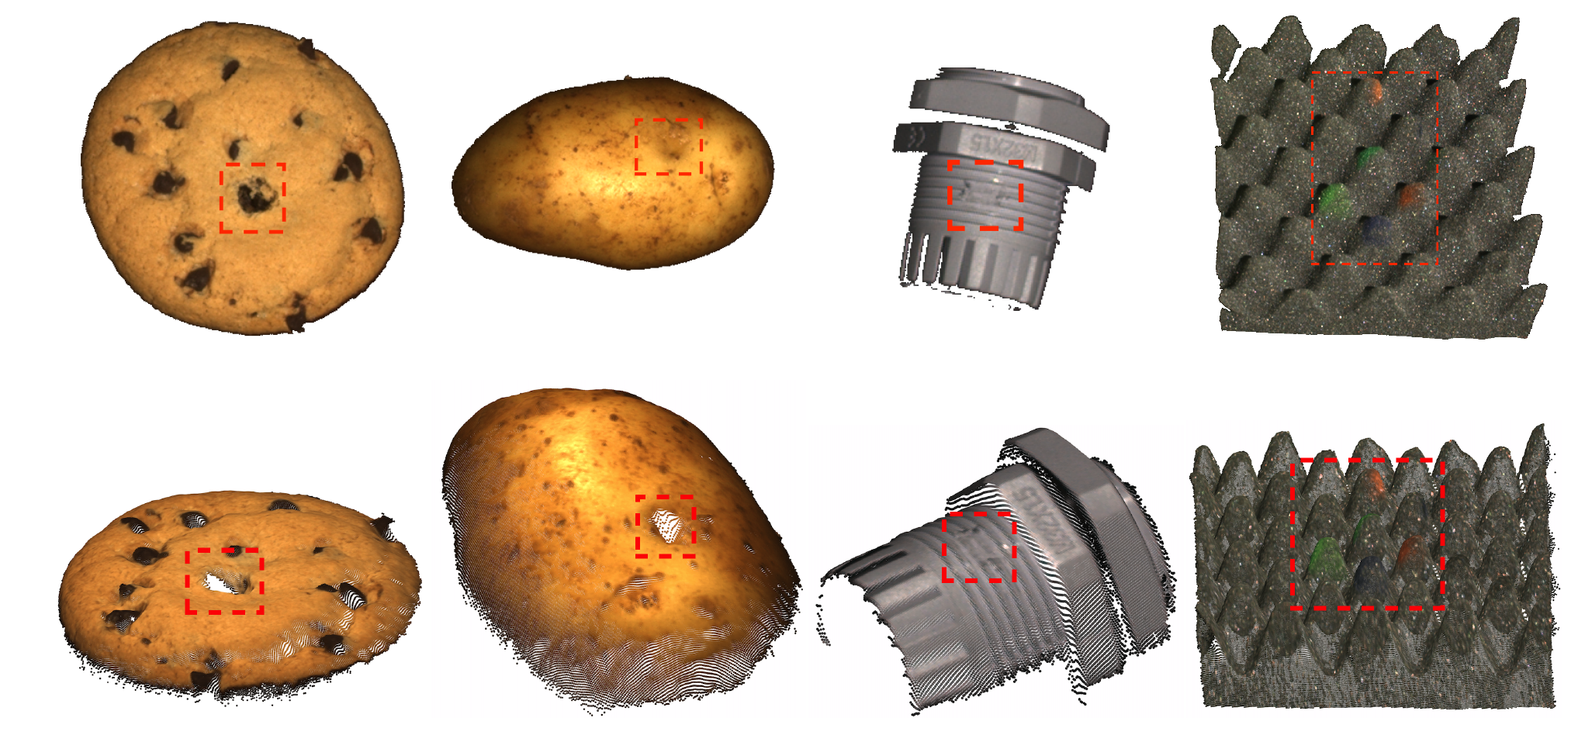
The Best Representation is Not Always Deep
We found that simple handcrafted representations are sometimes SoTA:
Time series: random projection features of each window
3D point clouds: classical rotation-preserving features (e.g. FPFH)
Tabular data: raw data (deep or handcrafted features did not improve – when no prior)
An Empirical Investigation of 3D Anomaly Detection and Segmentation, Horwitz and Hoshen, 2022
Time Series Anomaly Detection by Cumulative Radon Features, Tzachor and Hoshen, 2022
Perspective Paper, Anomaly Detection Requires Better Representations, Reiss, Cohen, Horwitz, Abutbul, Hoshen, ECCVW 2022

Slide 25
Story So Far
Anomaly detection requires a representation such that:
The PDF of normal data is easy to estimate
Small overlap between PDFs of normal and unknown anomaly distributions
This might be impossible in the adversarial case
In some important settings (presented here), a good representation may be guessed

Slide 26
Desiderata for Anomaly Detection Methods
Should be able to use all available data i.e., external and normal training data
Should be interpretable
Should be able to use guidance to resolve ambiguity
Should extend to all data modalities

Slide 27
Desideratum 1: Combining External and Internal Data
Anomalies are unexpected and not known at training time, but normal data are!
Previous SoTA: self-supervised training on normal training set only
Our experiments: externally pretrained encoders
Our challenge: can we combine pretraining with self-supervised adaptation?

Slide 28
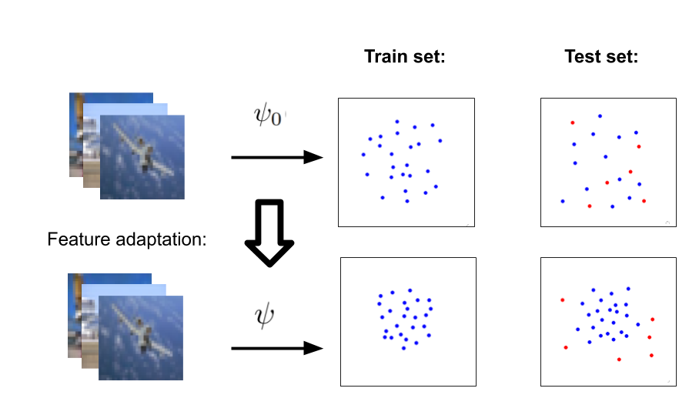
PANDA - Pre-trained ANomaly Detection Adaptation
Pretrain representation encoder on an external large-scale dataset (ImageNet)
Fine-tune pre-trained ResNet features using the compactness criterion
Use kNN scoring on the representations as before
Reiss, Cohen, Bergman, Hoshen, Panda: Adapting pretrained features for anomaly detection and segmentation, CVPR 2021

Slide 29
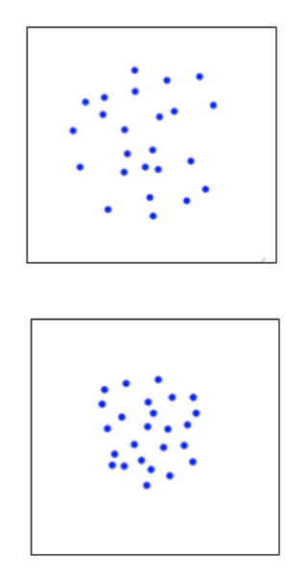
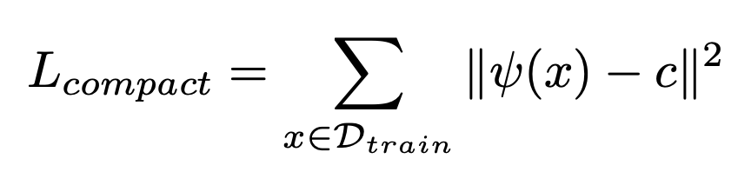
Adapting Pre-trained Features
Compactness criterion for fine-tuning features
Will this not collapse to a singular point? Catastrophic collapse?

Slide 30
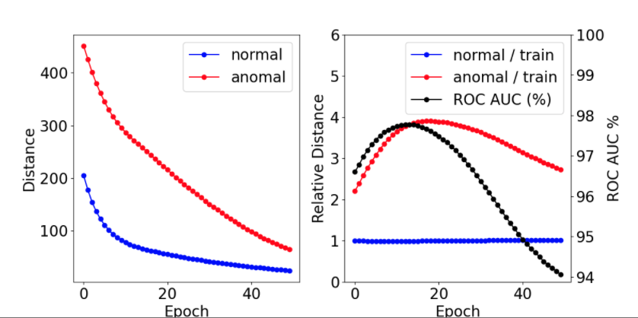
What about the feature collapse problem?
Instead of combatting forgetting we embrace it!
Fine-tune pre-trained features with the compactness criterion
Anomaly detection accuracy initially improves, then degrades:

Slide 31
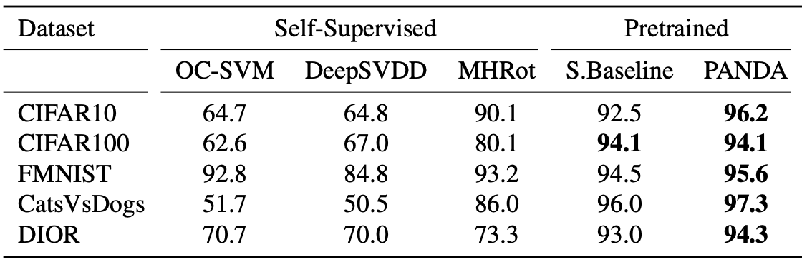
Seizing the moment
How to select the correct time to stop in unsupervised way?
Simple solution: early stopping after constant number of iterations
Rely on a hyper-parameter that may not generalize to new datasets
There are most principled solution but they don’t work much better

Slide 32
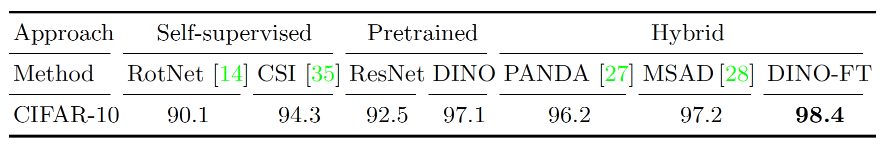
Our Latest Ideas: Mean Shifted and DINO
Our recent work has improved over PANDA in different key aspects
Moving away from using a compactness loss which assumes a singe normal class
Instead using the contrastive objective which can accommodate many normal classes
There are technical challenges that can be overcome:
Using our novel mean-shifted loss – when pretraining is supervised
Using the powerful DINO method - when pretraining is unsupervised
Reiss and Hoshen. Mean-shifted contrastive loss for anomaly detection. AAAI'23,

Slide 33
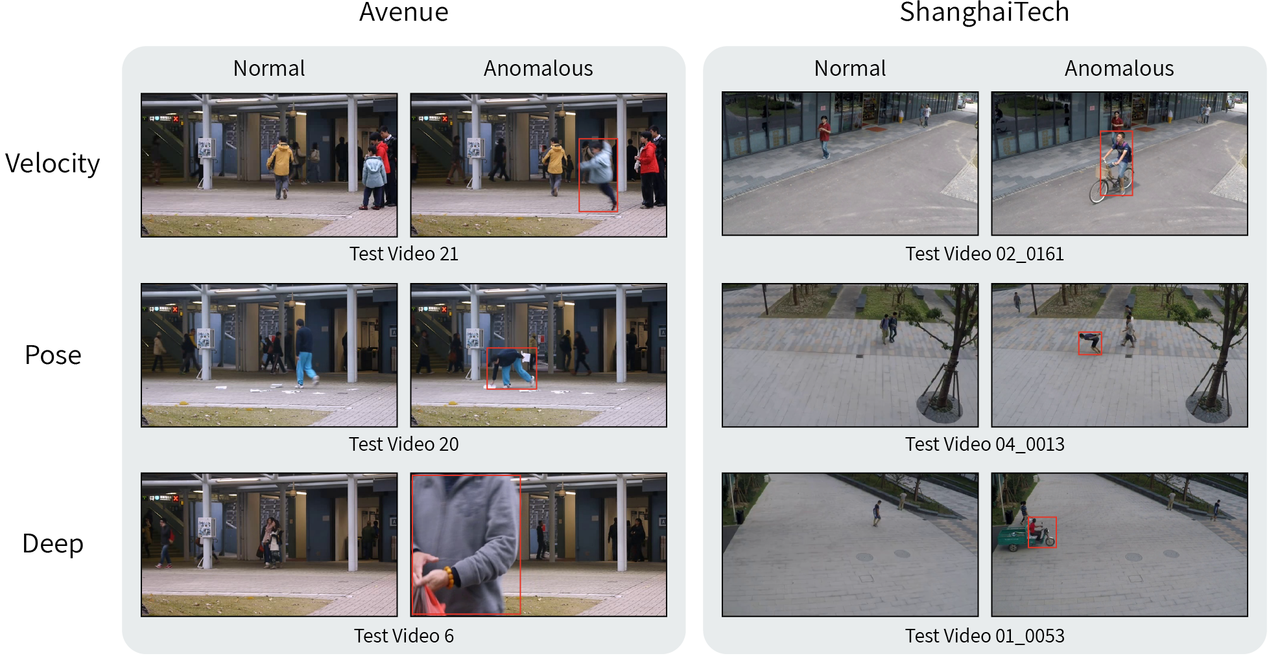
Desideratum #2: Interpretable Video AD
Deep learning is often not interpretable
This is critical for AD – we never gave computer any examples of anomalies
Here, we tackled task of video AD
Reiss and Hoshen, Attribute-based Representations for Accurate and Interpretable Video Anomaly Detection, Arxiv 2022

Slide 34
Unusual Velocity
In current datasets, unusual activity is expressed by unusual velocity or human pose

Slide 35
Unusual Human Pose

Slide 36
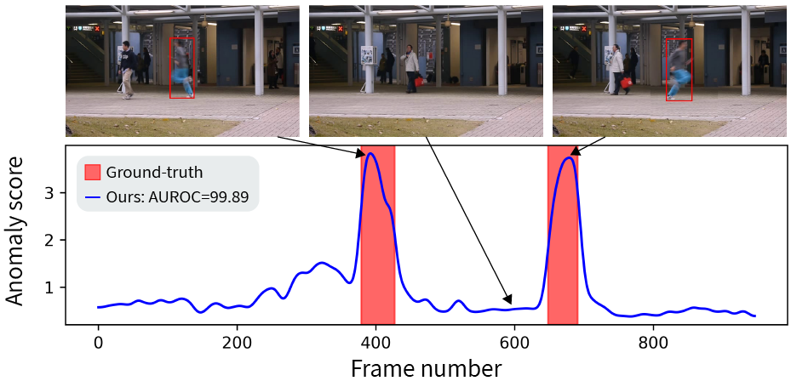
Attribute-Based Representation
We opt for an attribute-based representation for every object
Velocity attribute: represented by an optical-flow histogram with 9 orientation bins
Pose attribute: represented by the (x,y) coordinate of the human body landmarks
Estimate density for each attribute separately
This is inherently interpretable

Slide 37
Deep Residual
Not every anomaly is due to one of the two attributes
We detect residual attributes using a deep (non-interpretable) representation
We use a CLIP image extractor, kNN density estimator

Slide 38
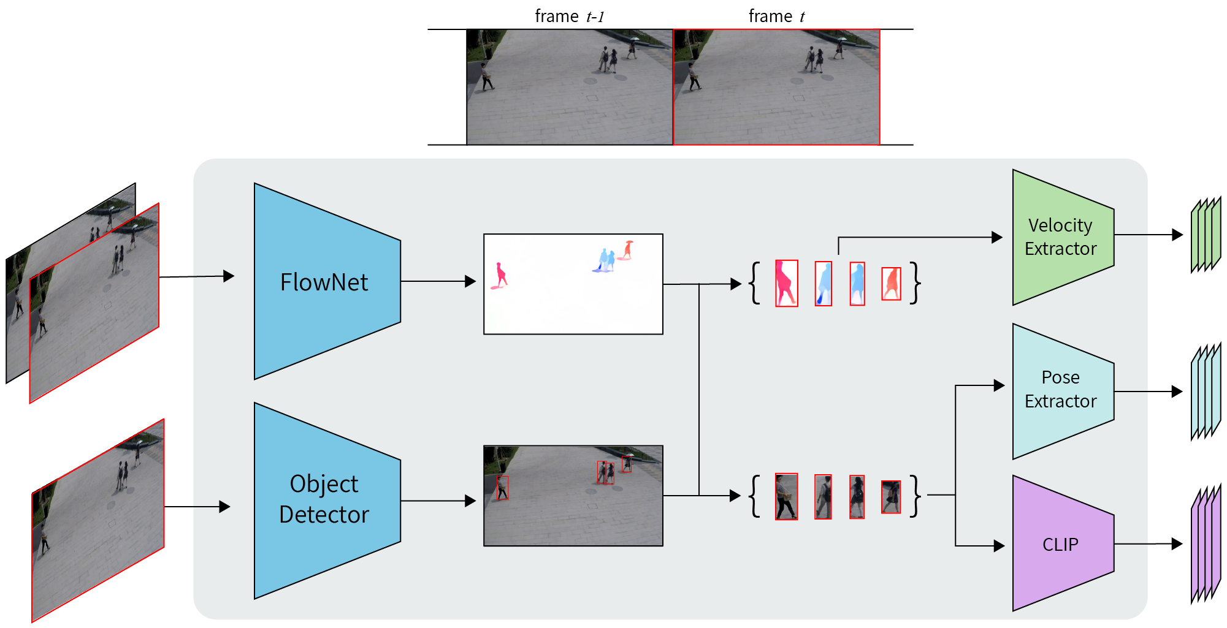
Entire System

Slide 39
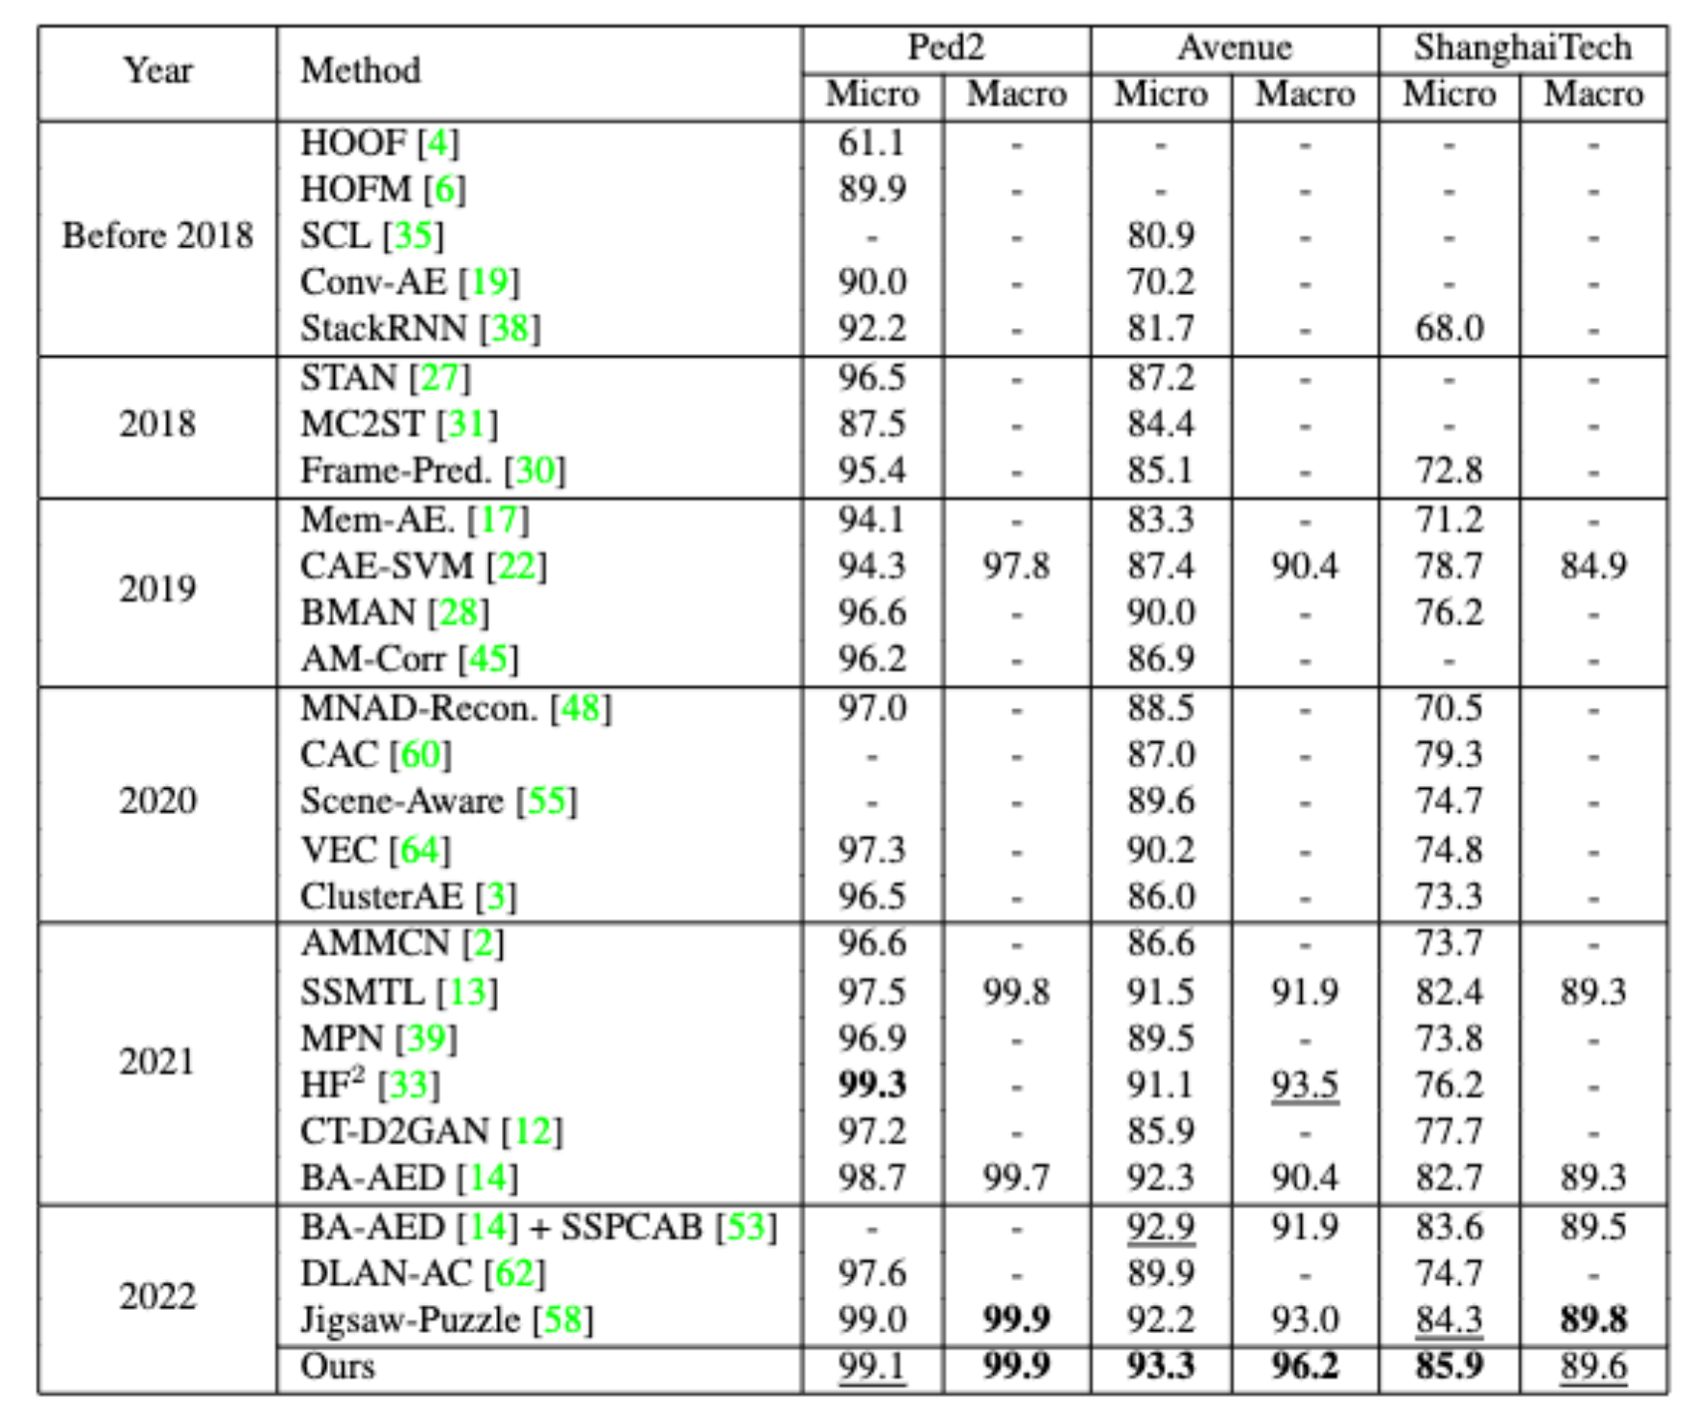
Surprisingly, This is SoTA
Our method outperform much more complex, and less interpretable methods
Academic unsupervised video AD datasets are probably too easy

Slide 40
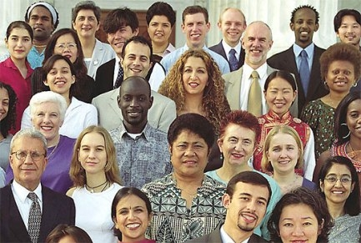
Desideratum #3: Dealing with Ambiguity
Two humans can disagree on data deemed anomalous
There exists a coordinate system to make every point anomalous
How can ML deal with this ambiguity?

Slide 41
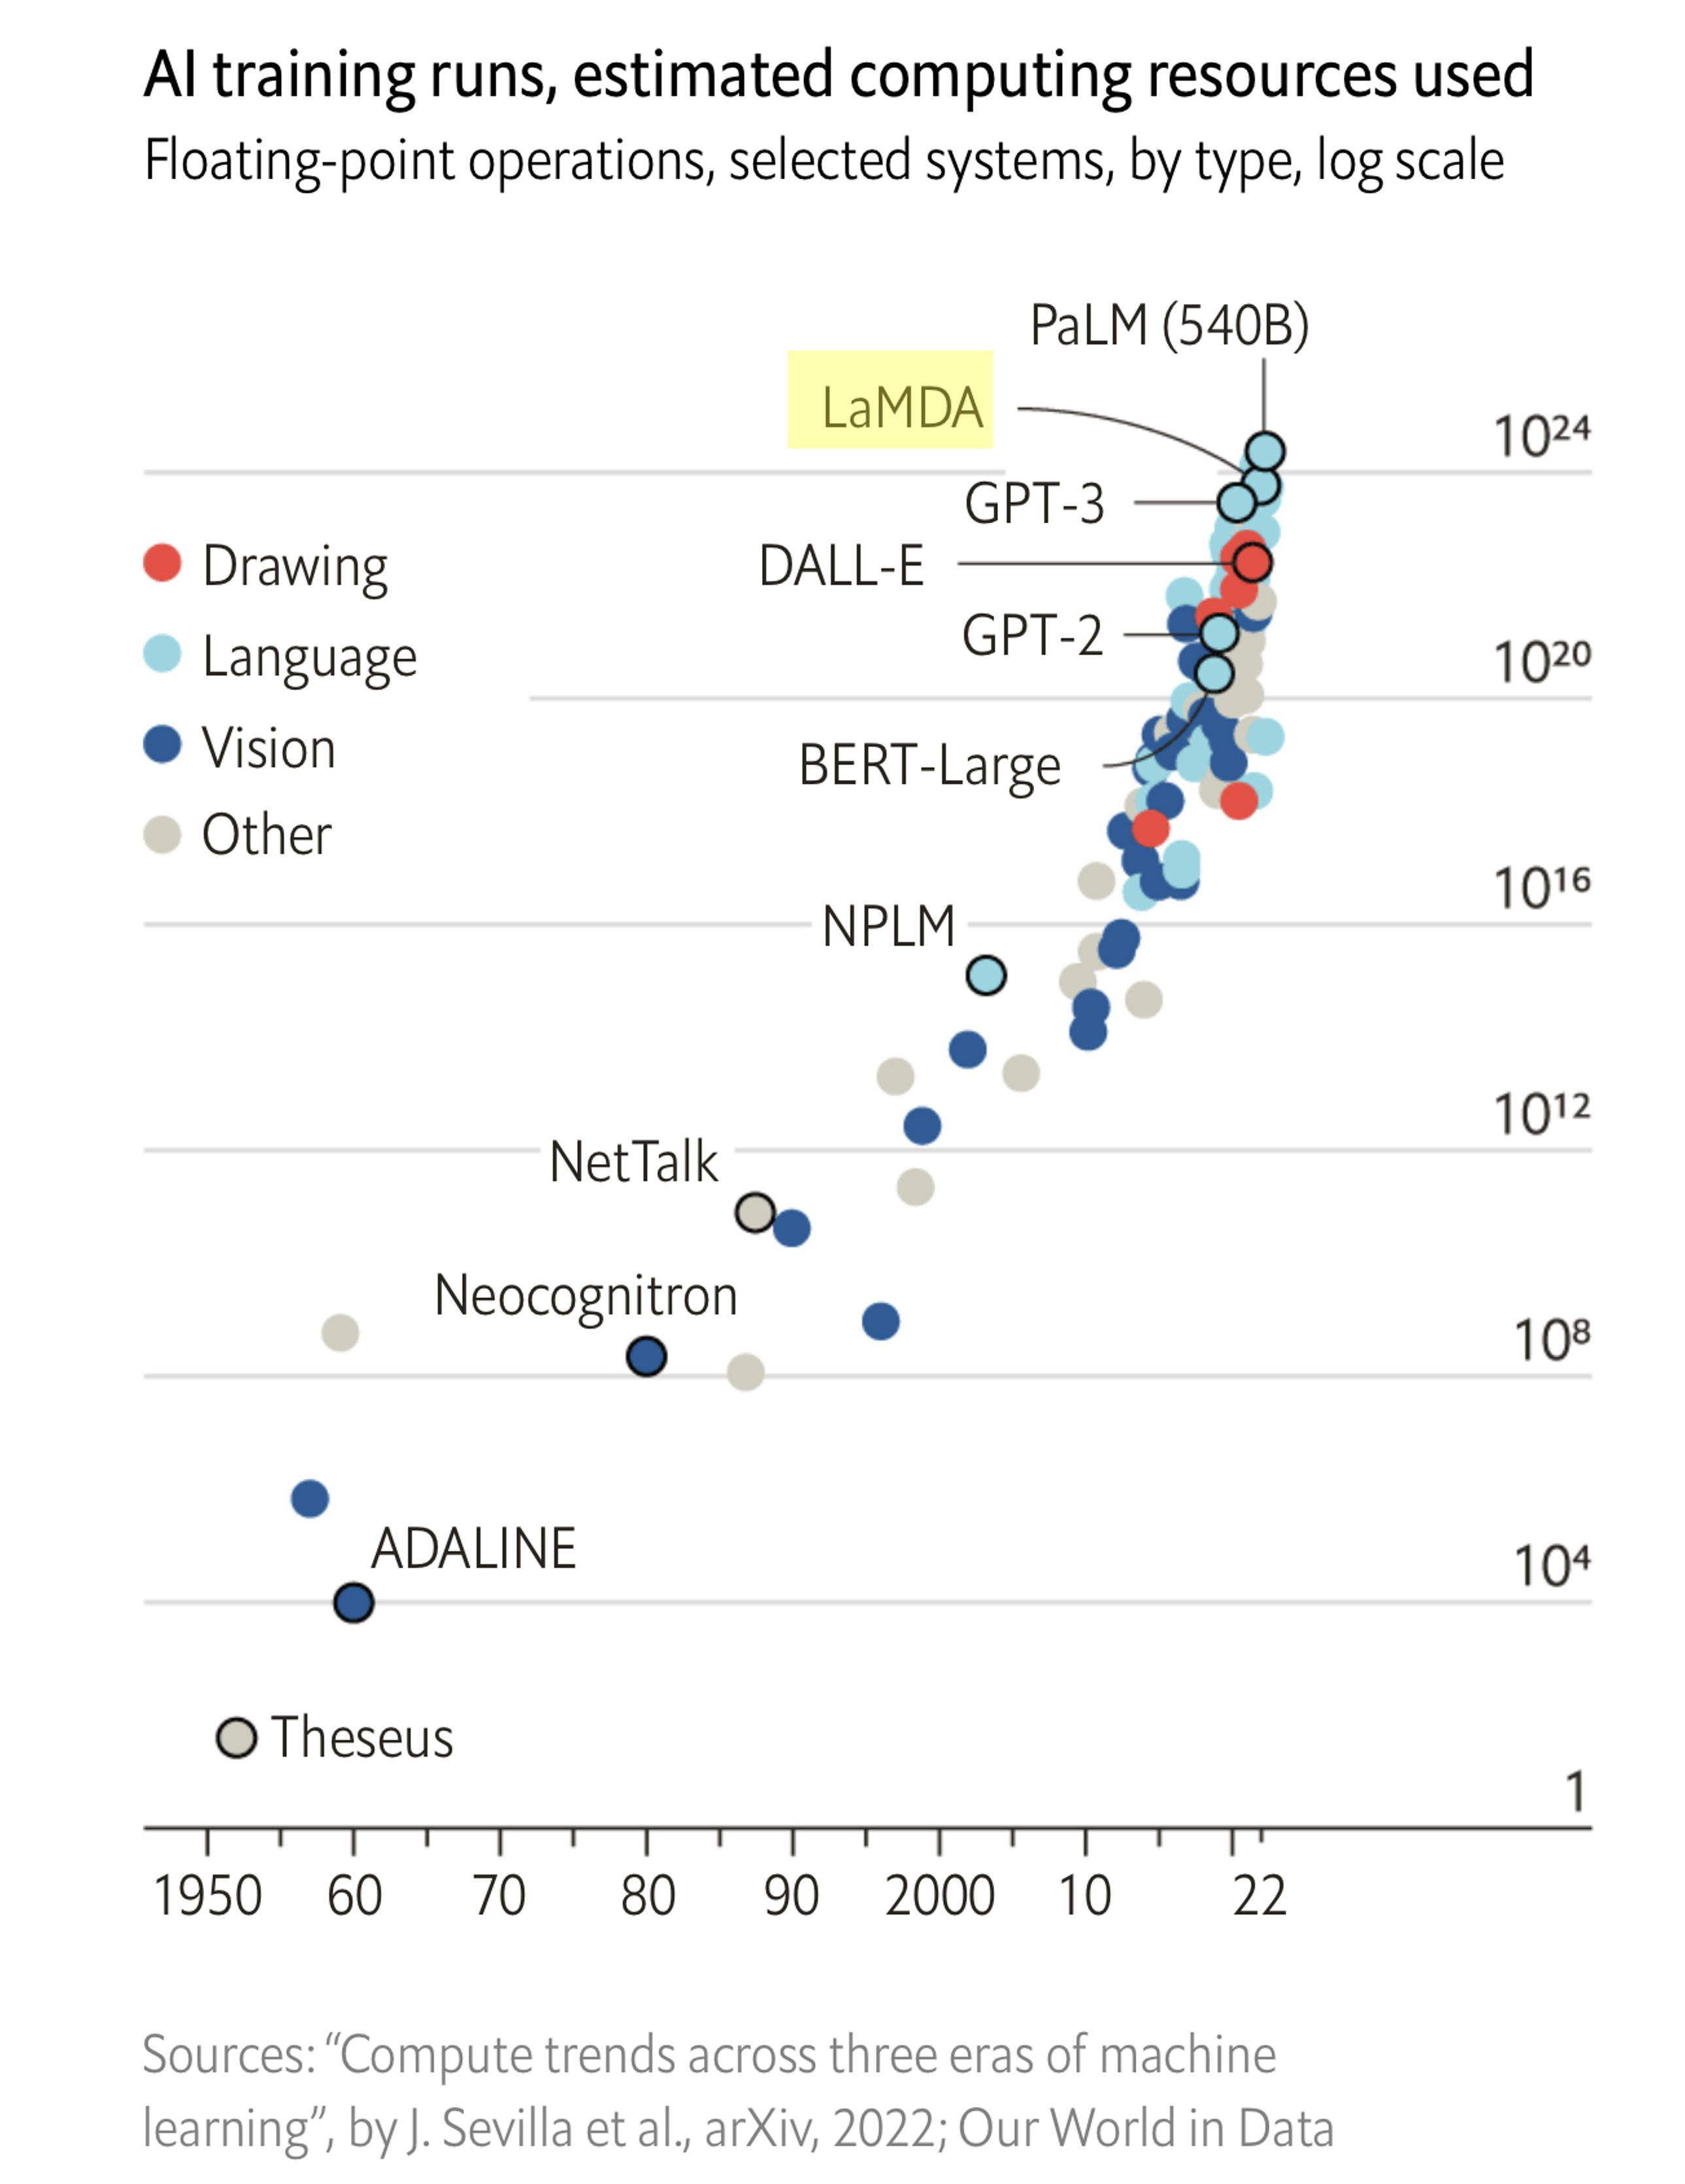
Can Scaling Up FM Improve AD Indefinitely?
We saw that powerful FMs result in large improvements to AD
Begs the question: can scaling-up even more solve AD?
Computation vs. accuracy in language models

Slide 42
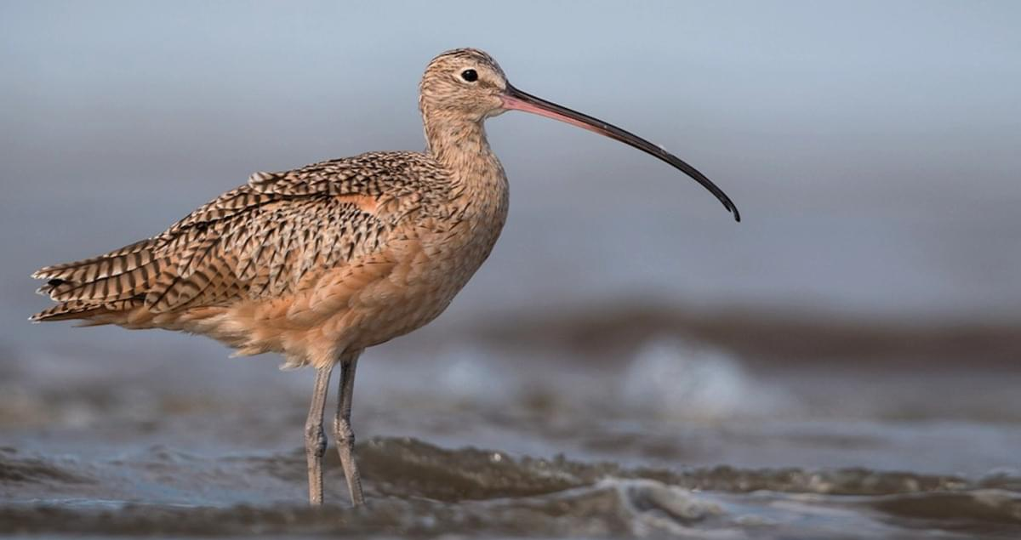
Example: Anomalous Bird Detection
Training: many bird images
Variation attributes: species, background, wing length, pose …
Test:
Normal: same distribution as training
Anomaly: very long beak
Can we use FMs to detection anomalies?

Slide 43
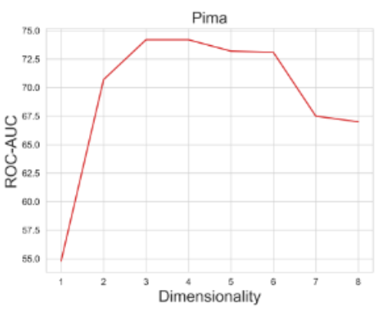
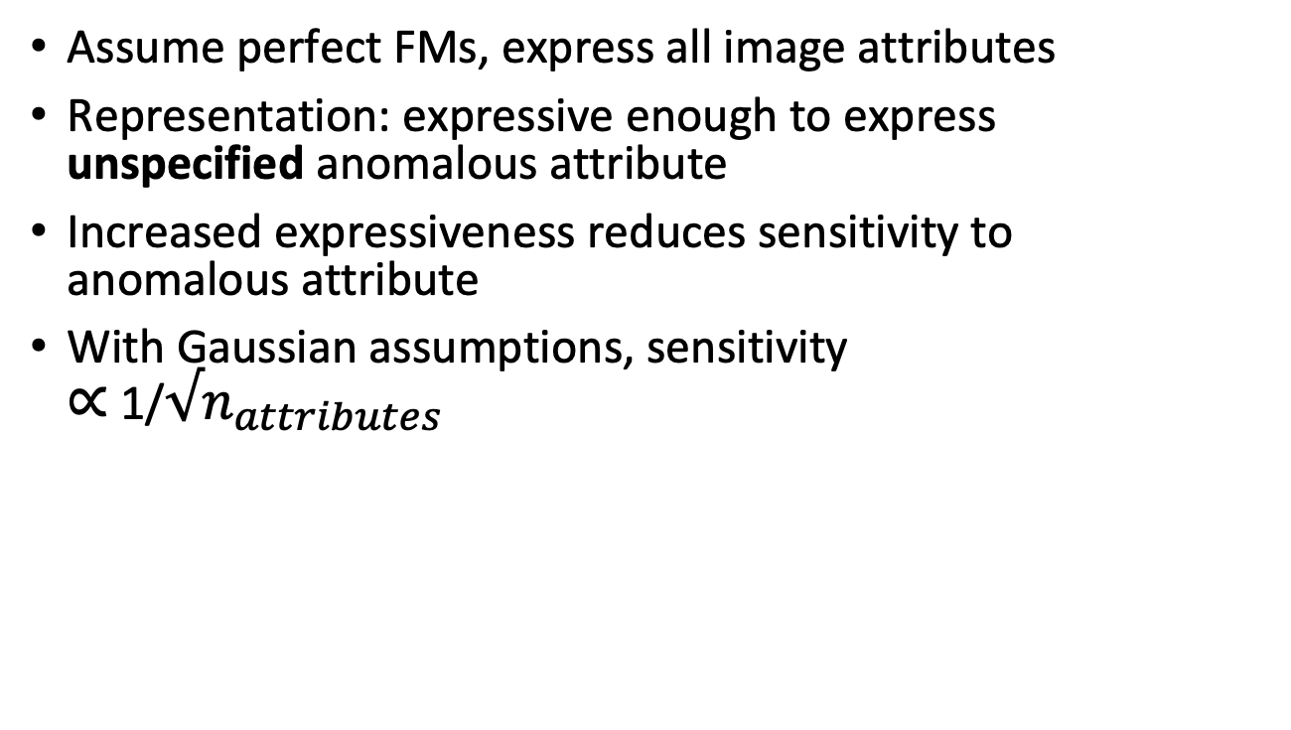
Expressivity-Sensitivity Tradeoff
Assume perfect FMs, express all image attributes
Representation: expressive enough to express unspecified anomalous attribute
Increased expressiveness reduces sensitivity to anomalous attribute
With Gaussian assumptions, sensitivity $∝$ 1/$√n_{attributes}$
Reiss, Cohen, Hoshen, No Free Lunch: The Hazards of Over-Expressive Representations in Anomaly Detection

Slide 44

No Free Lunch
Principle: A successful anomaly detection algorithm must choose the smallest number of attributes which include the (unspecified) anomalous attribute
Informal Collorary: there is no one FM representation that fits all

Slide 45
Asking Users for Guidance
How can users guide the learned representations?
A few labeled anomalies: will not generalize to unseen anomalies
Ask about the relevant and nuisance attributes:
Relevant: ”Object category is the most relevant attribute for detecting anomalies”
Nuisance: “Gender is irrelevant for detecting anomalies”

Slide 46
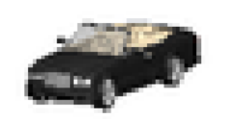
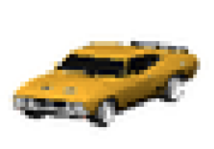
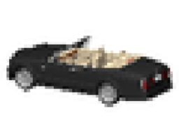
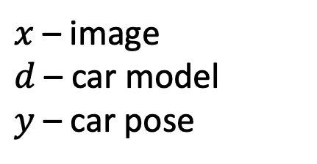
Nuisance Guidance for AD: Example
Nuisance attribute guidance: car model is irrelevant for anomaly detection
Training set: side facing coupes and front facing sedans
Front facing jeep: normal
Back facing jeep: anomaly
$x$ – image
$d$ – car model
$y$ – car pose

Slide 47
Representations Invariant to Nuisance Attributes
Idea: ignore nuisance by learning representations invariant to nuisance attributes
The invariant representation can then be used for kNN retrieval
[1] Kahana and Hoshen. A contrastive objective for learning disentangled representations. ECCV’22,
[2] Cohen, Kahana and Hoshen, RedPANDA, Arxiv’22

Slide 48

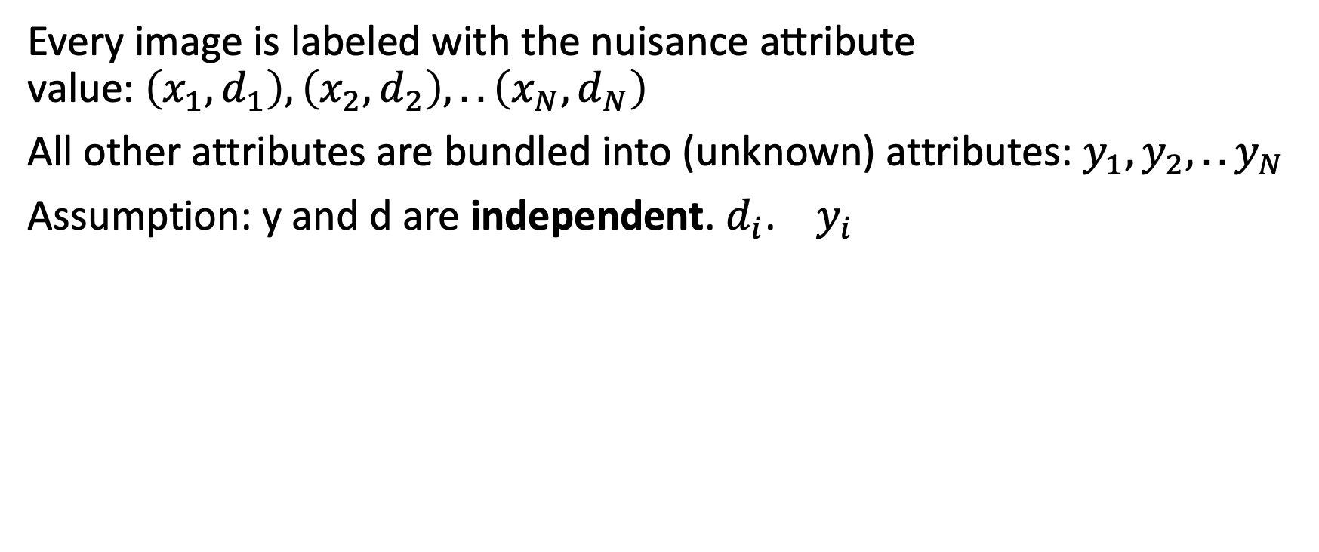
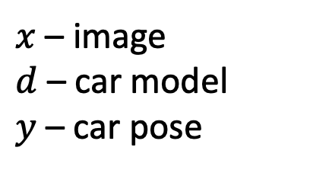
Task
Every $\text{image} \text{is} \text{labeled} \text{with} \text{the} \text{nuisance} \text{attribute} \text{value}\text{:} \left(x_{1}, d_{1}\right), \left(x_{2}, d_{2}\right), .. \left(x_{N}, d_{N}\right)$
All other attributes are bundled into (unknown) attributes: $y_{1}, y_{2}, ..y_{N}$
Assumption: y and d are independent. $d_{i}$. $y_{i}$
$x$ – image
$d$ – car model
$y$ – car pose

Slide 49
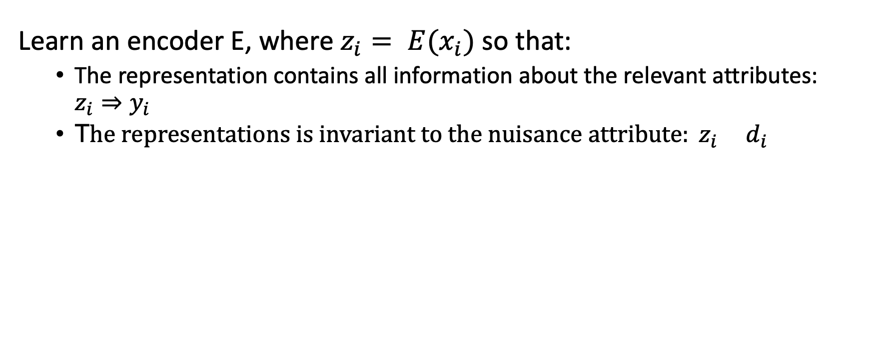
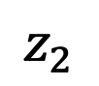
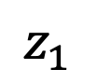
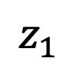
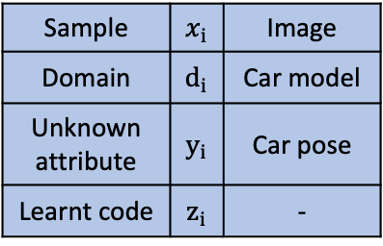
Representation for Unknown Attribute
Sample | $$x_{i}$$ | Image
Domain | $$d_{i}$$ | Car model
Unknown attribute | $$y_{i}$$ | Car pose
Learnt code | $$z_{i}$$ | -
Learn an encoder E, where $z_{i}= E(x_{i})$ so that:
The representation contains all information about the relevant attributes: $z_{i}⇒y_{i}$
T$he representations is invariant to the nuisance attribute: z_{i} d_{i}$
$$z_{2}$$
$$z_{1}$$
$$z_{1}$$

Slide 50
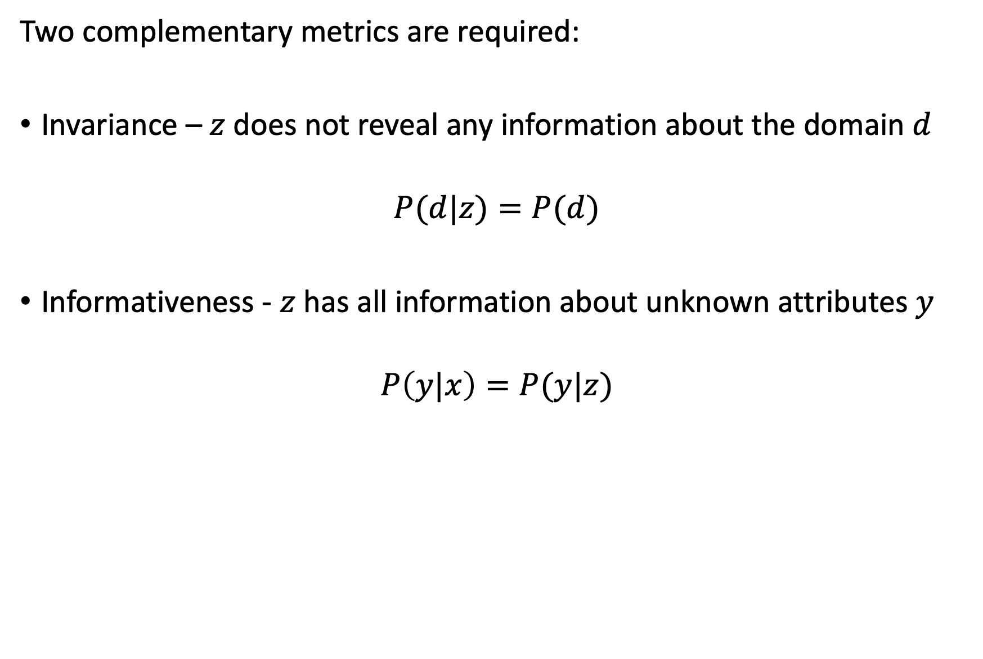
Disentanglement Goals
Sample | $$x_{i}$$ | Image
Domain | $$d_{i}$$ | Car model
Unknown attribute | $$y_{i}$$ | Car pose
Learnt code | $$z_{i}$$ | -
Two complementary metrics are required:
Invariance – $z$ does not reveal any information about the domain $d$
$$P(d|z)=P(d)$$
Informativeness - $z$ has all information about unknown attributes $y$
$$P\left(y|x\right)=P(y|z)$$

Slide 51
Theoretical Challenges for Anomaly Detection
Characterizing desirable representations, under different priors for the distribution of anomalies.
Characterizing conditions (distributional, supervision) when such representations be learned from the normal-only training data.

Slide 52
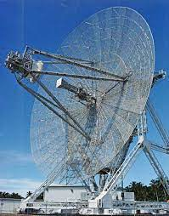
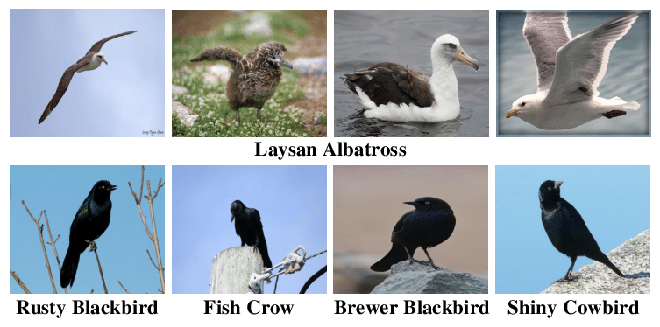
Practical Challenges for Anomaly Detection
Fine-grained AD: “Given all my previously seen birds, is this new bird anomalous?”
Interpretable AD for more general settings
Guidance: more effective human guidance with less effort
Desidertaum 4: AD beyond images

Slide 53
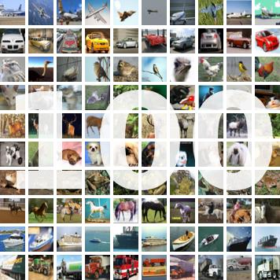
Clustering
Essential unsupervised task
Classify a set of images without training labels

Slide 54

Is Unsupervised Classification Ever Possible?
Hypothesis: classes form clusters in representation space
By detecting clusters – discover classes

Slide 55
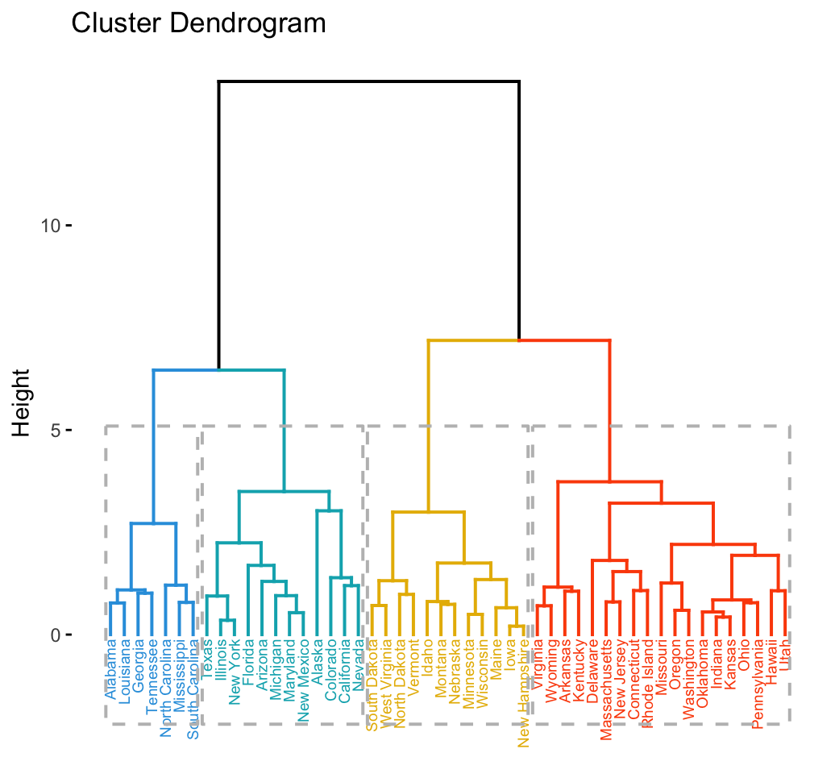
Hierarchical Clustering
Every point is initially designated a cluster
Merge clusters whose variance will increase the least
Repeat until only K clusters remain

Slide 56

K Means Clustering
You have seen this in IML

Slide 57
Latent-Variable Clustering
This can be formulated as a discrete latent variable model
Differently from VAE, here the latent variable has a small set of values
This is easy to compute
No need for importance sampling and proposal distributions

Slide 58
Classification With Latent Variable Models
To classify using latent variable model, use Bayes’ law

Slide 59
Gaussian Mixture Models (GMMs)
In GMMs, we assume that p(x|z) is Gaussian
All parameters are optimized using maximum likelihood
Extend to deep encodings by learning E and clustering e_{i} = E(x_{i})

Slide 60
Classification-Based Clustering
We make two assumptions:
We know the proportion of samples in each cluster (e.g. equal)
Every sample belongs to a single cluster only

Slide 61

Distribution Loss
Compute q(z=i) proportion of data assigned to z=i:
Loss is therefore the difference from the prior:

Slide 62
Classifier Confidence
We want classifiers to assign point confidently to a single class
Enforce low entropy, which does exactly that

Slide 63
Optimize Loss with Some Representation Loss
Optimize both confidence and proprtion loss
Typically easy to overfit, therefore all include some rep learning loss

Slide 64
Domain Generalization
Assume we have a labeled training set for domain A (photos)
A dataset with pairs of
We want a classifier that performs well on domain B (paintings)
Can we make. a classifier that generalizes cross domain?

Slide 65

Domain Generalization – Nothing Beats ERM
Nothing beats empirical risk minimization (just training) on domain A
As always, powerful pretraining and regularization helps
Lots of celever things tried, nothing really works ☹

Slide 66

Domain Adaptation
Assume we have a labelled training set from domain A
We also have an unlablled set of images from domain B
Can we now do better?

Slide 67
Combining Classification + Clustering
We can combine classification loss for A and clustering losses for B
Limitation: works when classifier trained on A works ok on B
Otherwise, even if clustering works, clusters will be mislabeled

Slide 68
Looking Back
In this course, we focused on long standing ML ideas
Modern breakthroughs are simple (but clever) extension

Slide 69
Looking Back
In this course, we focused on long standing ML ideas
Modern breakthroughs are simple (but clever) extension

Slide 70
Generative models – AR Models
Classical: Auto-regressive models on discrete data
SoTA: Replace the function approximator by a transformer

Slide 71
Generative models – Variational Inference
Classical: Variational approximation for likelihood estimation of latent variable models using importance sampling
SoTA: Replace the latent optimization of thr sampling distribution q(z|x) = N(mu_x, sigma^2_x) by an amortized encoder E(x)

Slide 72
Generative models – Diffusion models
Classical idea:
1) create a forward diffusion model by adding Gaussian noise to sample
2) invert this process by the reverse diffusion process, requiring the score
Idea for 2010 (Vincent) – score estimation by denoising
SoTA idea: use deep network for denoising

Slide 73
Generative Models – IPM and GANs
Classical idea: compute distance between distributions using the integral probability metric (IPM) with Lipschitz-1 functions
SoTA idea:
1) Use to train generator networks minimizing distance between gen and real
2) Estimate IPM using a deep neural network discriminator

Slide 74
Representation Learning – Local and VicReg
Classical ideas:
Compute local region by finding kNN using L2
Enforce embeddings of local regions to be similar
SoTA idea:
Use augmentations to create local region
Use encoder to map sample to representation

Slide 75
Rep. Learning – SNE and Contrastive
Classical ideas:
Compute distribution-like weighting between points using softmax on L2
Do the same thing for embeddings
Optimize eembeddings using KL between distributions
SoTA idea:
Use augmentations to create one-hot distribution for points
Use encoder to map sample to embedding

Slide 76
Rep. Learning – CCA and Barlow Twins
Classical ideas:
Embeddings of two views of the same sample have correlation identity
SoTA idea:
Use augmentations to create views
Use encoder to map sample to representation

